Slide 1

Peter Eijgermans
ICT Consultant Ordina JTech
Notes:
1 sec
Agenda:
First part NS
Second part NS+A
http://angularjs.blogspot.nl/2015/12/building-mobile-apps-with-angular-2-and.html

Slide 2


What is NativeScript?
A runtime for building and running
native iOS and Android apps
with JavaScript code base
without web views !
Notes:
Building apps without web views (= without using the Browser on your device)
8 sec – 25 sec
.

Slide 3


App Store / Google Play
Search for "NativeScript Examples" and install
Notes:
26 sec

Slide 4
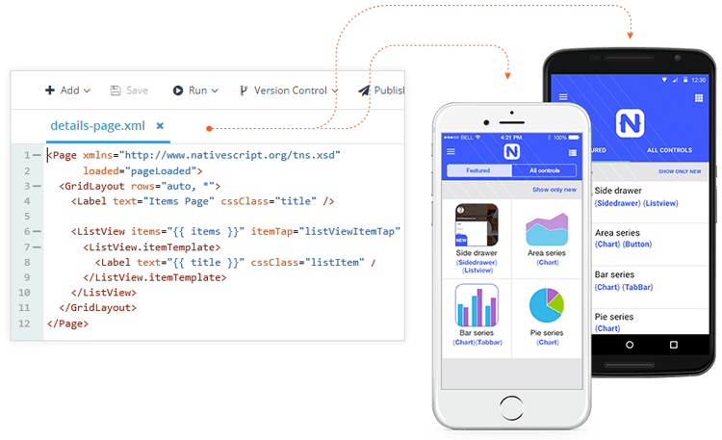
Cross Platform
iOS
Android
Windows (2017)
Notes:
32 sec
Write ones in JS, run everywhere!
SINGLE CODE BASE = JavaScript

Slide 5
Why NativeScript?
Skills reuse
Standards-based on JavaScript, CSS, TypeScript , Angular
Code reuse
NPM modules and iOS and Android libraries
Native APIs
No web views, Not Hybrid!
Open source!
Quick to learn
Notes:
45 sec
Direct access to native APIs via JavaScript → better performance !

Slide 6



Choice in Architecture
Javascript
Write your application using plain Javascript
TypeScript
Use TypeScript to get Object Oriented features and compile time error checking
Angular
Use Angular to architect application.
Reuse all code between Web and mobile!
Notes:
1.27

Slide 7
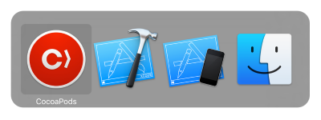


Use Lots of Prebuilt code
Notes:
1.57 sec
A NativeScript plugin is any npm package that exposes a native API via JavaScript
Cocoapods = Dependency manager for Swift / ObjC
When you develop for iOS, you can quickly add third-party libraries to your NativeScript projects via the CocoaPods dependency manager.

Slide 8
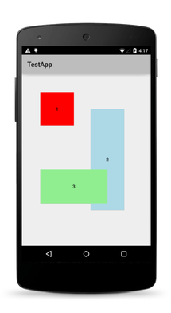
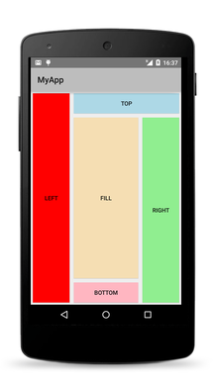
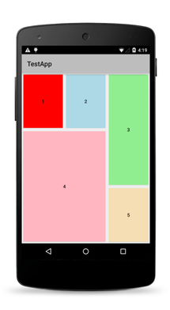
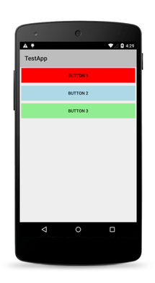
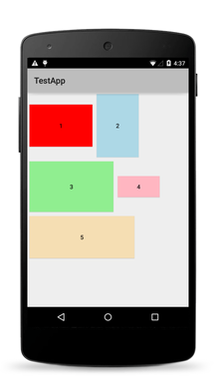
Native Layouts
Absolute
Dock
Grid
Stack
Wrap
Notes:
2.06

Slide 9
Not PhoneGap/Ionic/Cordova
NativeScript
No browser, No DOM
Direct access to native platform APIs
NativeScript has better performance
More productive (TypeScript)
Notes:
2.19

Slide 10

Not Xamarin
NativeScript
100% access to native APIs without writing bindings
No C#
Notes:
https://www.nativescript.org/blog/nativescript-and-xamarin
2.39

Slide 11
Not React Native
NativeScript
NativeScript: “write ones run everywhere!”
Use CSS for styling!
More productive (TypeScript)
Notes:
3.03

Slide 12
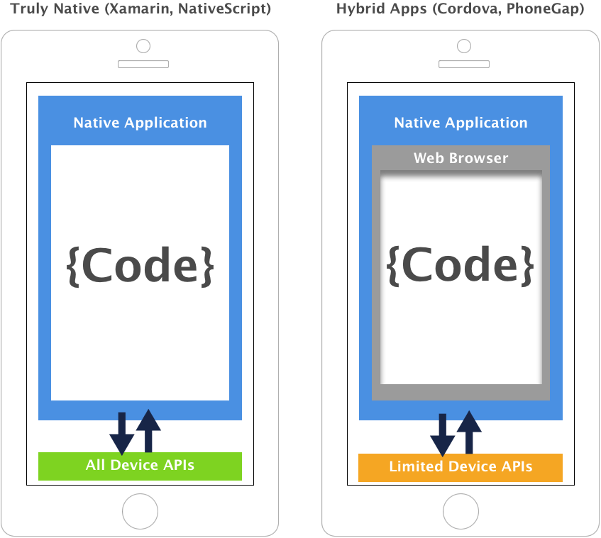
Notes:
3.46

Slide 13

Created and supported by Telerik
Notes:
I mention this because, in today’s world, where 10 JavaScript frameworks have been created since I started this presentation, that it’s important to pick an innovative and stable options
4.24

Slide 14
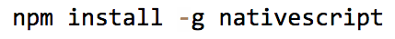


NativeScript CLI requirements
JDK, Android SDK
Xcode, iOS SDK
Notes:
4.29

Slide 15
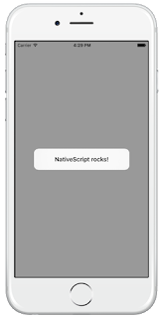

NativeScript using IOS-code
var myAlert = new UIAlertView();
myAlert.message = "NativeScript rocks!";
myAlert.show();
Notes:
This JavaScript code instantiates an iOS UIAlertView, sets its message property and calls the show() method.
4.57

Slide 16
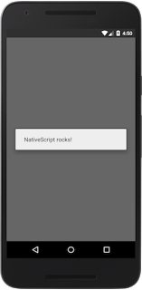
NativeScript using Android-code
var myAlert = new android.app.AlertDialog();
myAlert.message = "NativeScript rocks!";
myAlert.show();
Notes:
Same code: But this JavaScript code instantiates a Java/Android Object
5.11

Slide 17

Notes:
No web developer wants to learn iOS- and Android-specific APIs
5.15

Slide 18


NativeScript modules
Code
Modules
Platform API
Notes:
Solution: NativeScript uses modules in the middle.
5.23

Slide 19
Using the NativeScript Dialog Module
var dialogs = require("ui/dialogs"); dialogs.alert({ message: "NativeScript rocks!" });
android.app.AlertDialog()
UIAlertView()
Notes:
For instance, the Android and IOS code could be rewritten using the NativeScript dialogs module
5.47

Slide 20
NativeScript modules
Notes:
A NativeScript plugin is any npm package that exposes a native API via JavaScript
Cocoapods = Dependency manager for Swift / ObjC
When you develop for iOS, you can quickly add third-party libraries to your NativeScript projects via the CocoaPods dependency manager.
6.04

Slide 21
HTTP module example
var http = require(“http”); → import HTTP module
http.getJSON(“https://api.myservice.com”)
.then(function (result)) {
…..
});
Notes:
6.15
What does this module do: Allows you to send web requests and receive the responses.
------------------------
It gets even better.
NativeScript actually includes support for web APIs, like XMLHttpRequest
This support means: NativeScript translate this XMLHttpRequest web API to NATIVE CODE for your mobile apps.

Slide 22
Challenge !
Sharing Code Between Web And Native apps!
Notes:
6.26
We still CANNOT share code between our Web and Native Apps with NativeScript!

Slide 23
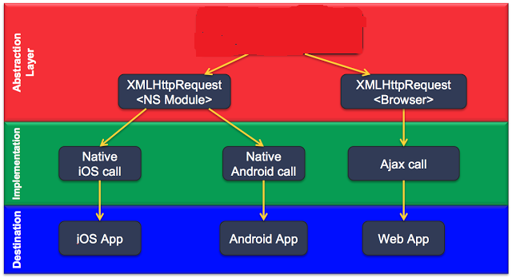
Notes:
6.44
MISSING LINK?
Left: represents the HTTP module for NS
Right: represent the HTTP module for the Web
Problem: we cannot share this code between our Web app and our NativeScript App
-----------------------
How does this looks like visualy:
‘’XMLHttpRequest NS Module’’ translate the ‘’XMLHttpRequest API’’ to native calls
MISSING LINK: different implementation in your web app →

Slide 24

337
Solution is Angular
Notes:
7.22
https://angular2-intro.firebaseapp.com/#/29
http://angularjs.blogspot.nl/2015/08/angular-1-and-angular-2-coexistence.html
http://larseidnes.com/2014/11/05/angularjs-the-bad-parts/
Example GITHUB → https://github.com/r-park/book-angular2-firebase
http://tryangular2.github.io/#/section-9/page-37

Slide 25
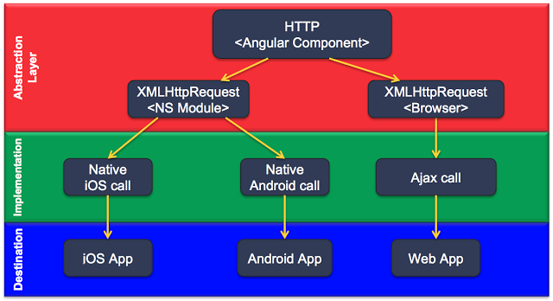
Notes:
7.30
Added an extra abstraction layer with Angular → 1 HTTP Module for Web and mobile
NOW WE CAM SHARE CODE !

Slide 26

Intro Angular
TypeScript
Component based
DI
Efficient development
Notes:
7.50
TypeScript en Angular gaan hand in hand. TypeScript is een typed superset van JavaScript
Component based → Is herbruikare logica die je toevoegt aan je html-pagina.
Performance beter! → Betere/efficientere structuur: Angular Apps zijn opgebouwd volgens een boomstructuur.
Geen $Scope → Geen gezamenlijk gebruik van de Scope. Componenten zijn niet meer gekoppeld aan elkaar middels $Scope.
DI – Wordt gebruik gemaakt van interfaces (niet van concrete implementaties)
IDE → refactoring + autocompletion + type error op compilatie en runtime nivo
http://www.technofattie.com/2014/03/21/five-guidelines-for-avoiding-scope-soup-in-angular.html
http://busypeoples.github.io/post/thinking-in-components-angular-js/
- Gezamenlijk gebruik van $scope door meerdere controllers → controller kunnen niet afzonderlijk getest worden.
Problemen met scope in controller:
Niet makkelijk te testen
Controller is gekoppeld aan $scope
Controller niet herbruikbaar
Controller moeilijk te onderhouden
Gezamenlijk gebruik van $scope door meerdere controllers
- Scope kan je niet migreren

Slide 27
Component based
A component adds logic to a DOM elementen
Angular app consist of a treestructuur of components
Index.html
AppComponent
app.template.html
LoginComponent
GroceryListComponent
grocerylist.template.html
GroceryCmp
GroceryCmp
…
Notes:
8.29
Angular is a tree of components, because it has the same structure as your html-structure !!!
Index.html is the parent template of AppComponent ect…
AppComponent is the parent of LoginComponent and GroceryListComponent

Slide 28
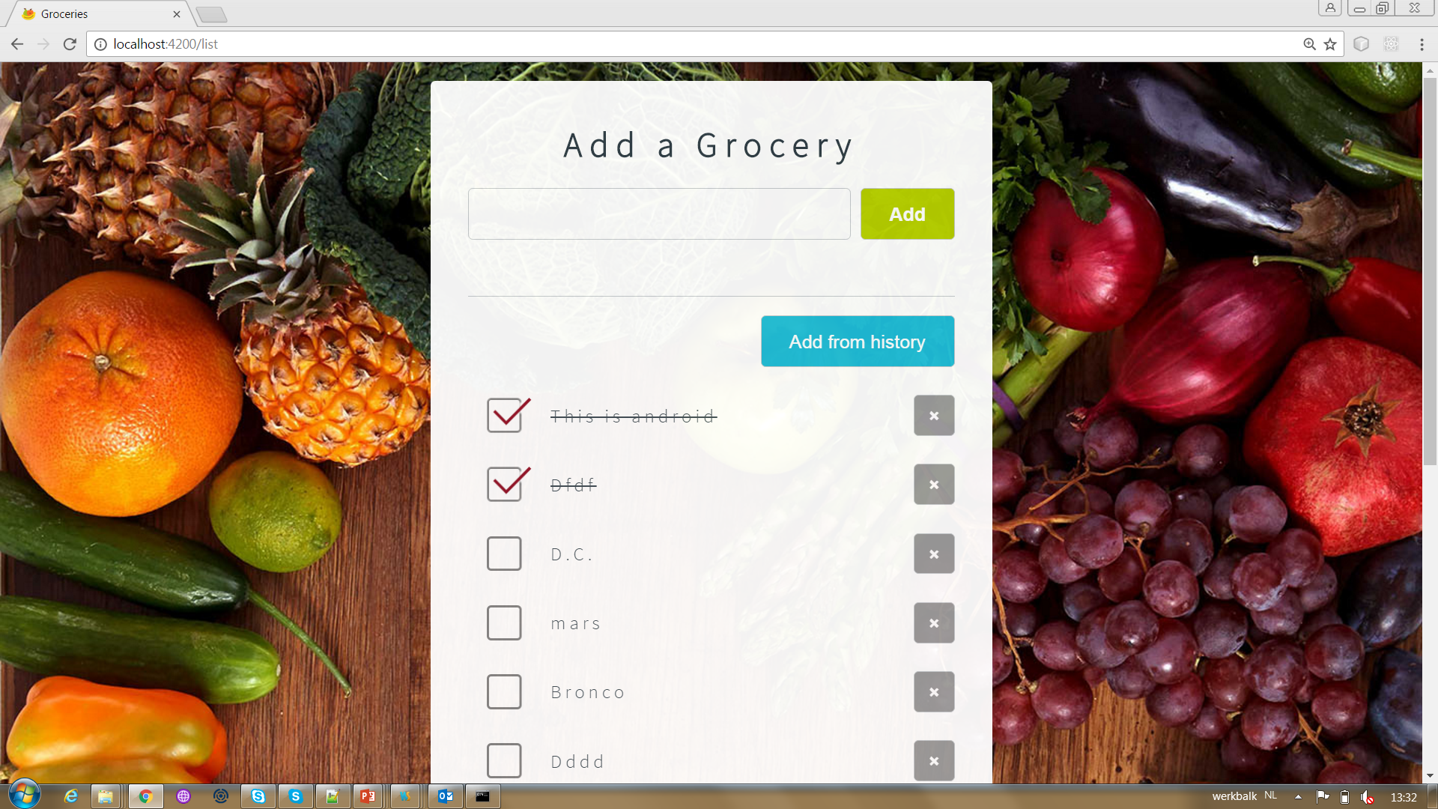
GroceryList Component
Notes:
9.33

Slide 29
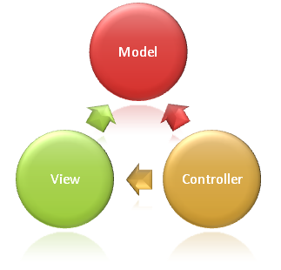
Syntax Component
import {Component} from ‘@angular/core';
@Component({
selector: ‘grocery-list'
templateUrl: ‘grocerylist.template.html'
})
export class GroceryListComponent {
groceries: string[];
constructor() {
this. groceries =[‘grocery1’, ‘grocery2’]
}
}
Notes:
9.38
Structuur
This class is written in Typescript!
How to convert this class in a Component:
- You import the Typescript libraries from Angular ---> a Component is imported here
- You can now convert the class in a Component with the @Component annotation
- templateUrl - the address of this component's template
How does this work in action
With the selector you can instantiate and call the component
With the CSS selector you can tell Angular to create an instance of this component where it finds a <grocery-list> tag in parent HTML.
You export the Component class so that you can import and use it in the rest of your application.

Slide 30
Selector in index.html
….
<grocery-list></grocery-list>
….
Notes:
10.34

Slide 31
Syntax grocerylist.template.html
<p>Groceries: </p>
<ul>
<li *ng-for = “let grocery of groceries">
{{grocery}}
</li>
</ul>
Notes:
10.45
The STAR Turns the li element and its contents into a template, and uses that to instantiate a view for each item in list.
https://angular.io/docs/ts/latest/guide/template-syntax.html#!#star-template
*ng-for – Why?

Slide 32


Slide 33
Angular in NativeScript?
change => template/view
Notes:
11.31
Use NativeScript’s UI components instead of browser-based HTML-elements

Slide 34
Syntax Component in NativeScript
import {Component} from ‘@angular/core';
@Component({
selector: ‘grocery-list'
templateUrl: ‘grocerylist.template.html'
})
export class GroceryListComponent {
groceries: string[];
constructor() {
this. groceries =[‘grocery1’, ‘grocery2’]
}
}
Notes:
11.36
The component is still the same in NativeScript

Slide 35
Syntax grocerylist.template.html
<StackLayout *ngFor = "let grocery of groceries">
<Label [text]=“grocery"></Label>
</StackLayout>
<p>Groceries: </p>
<ul>
<li *ng-for = “let grocery of groceries">
{{grocery}}
</li>
</ul>
Notes:
11.41
Usage: NativeScript UI Widgets
REUSE of *ngFOR

Slide 36
CSS
Label {
color: red;
font-size: 20;
width: 200;
margin: 20;
}
Notes:
12.01

Slide 37
Benefits of using NativeScript and Angular
Reuse all code between Web and mobile!
Faster time to market
Use of existing developer skills
Notes:
12.21
Share Angular-code between NativeScript and webapp!!! → one code base to maintain
Less code for building native apps in Android or IOS

Slide 38
Downsides
JavaScript and Angular
XML templates
Optimizing background processes
Notes:
12.38

Slide 39
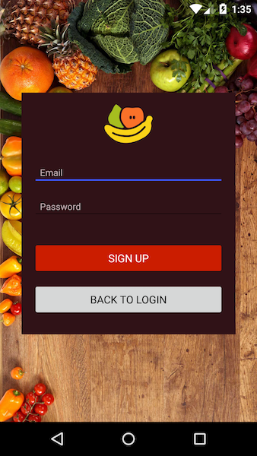
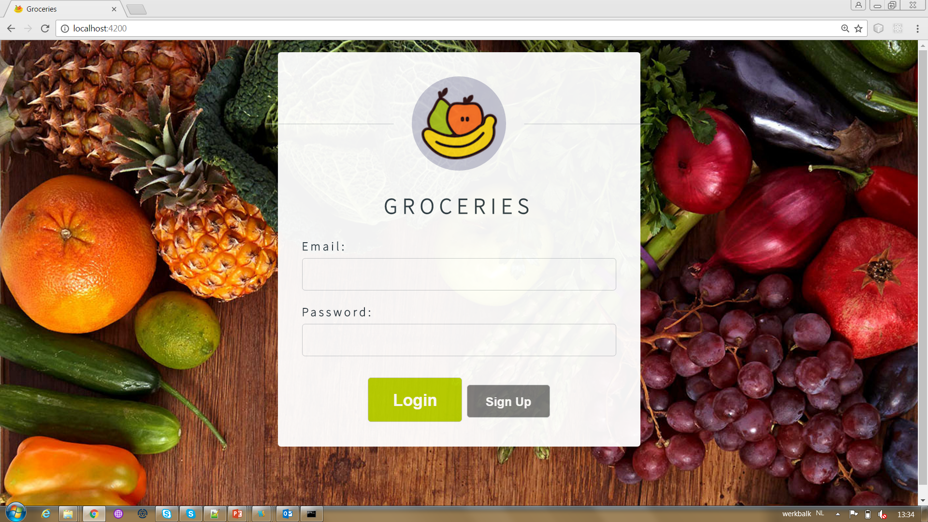
Now suppose that you want to make this component work on your NativeScript iOS and Android apps.
Notes:
13.22

Slide 40
import { Component } from "@angular/core";
@Component({
selector: "my-app",
template: `
<div class="login-page">
<form>
<div> Email:
<input name="email" type="email" required [(ngModel)]="user.email" >
</div>
<div> Password:
<input name=“password" type=“password" required [(ngModel)]="user.password" >
</div>
<button [text]="isLoggingIn ? ‘Login' : 'Sign up'" (submit)=“submit()></button>
<button [text]="isLoggingIn ? 'Sign up' : 'Back to login'" (click)="toggleDisplay()></button>
</form>
</div> `
})
export class LoginComponent {
user: User;
constructor() {}
submit() {}
toggleDisplay() {}
}
Notes:
13.36
Rewrite this component → change inline template

Slide 41
import { Component } from "@angular/core";
@Component({
selector: "my-app",
template: `
<StackLayout>
<TextField hint="Email Address" keyboardType="email“ [(ngModel)]="user.email“ >
</TextField>
<TextField hint="Password" secure="true“ [(ngModel)]="user.password"></TextField>
<Button [text]="isLoggingIn ? ‘Login' : 'Sign up'" (tap)="submit()></Button>
<Button [text]="isLoggingIn ? 'Sign up' : 'Back to login'" (tap)="toggleDisplay()"></Button>
</StackLayout> `
})
export class LoginComponent {
user: User;
constructor() {}
submit() {}
toggleDisplay() {}
}
Notes:
14.14

Slide 42
DEMO
Notes:
15 min

Slide 43
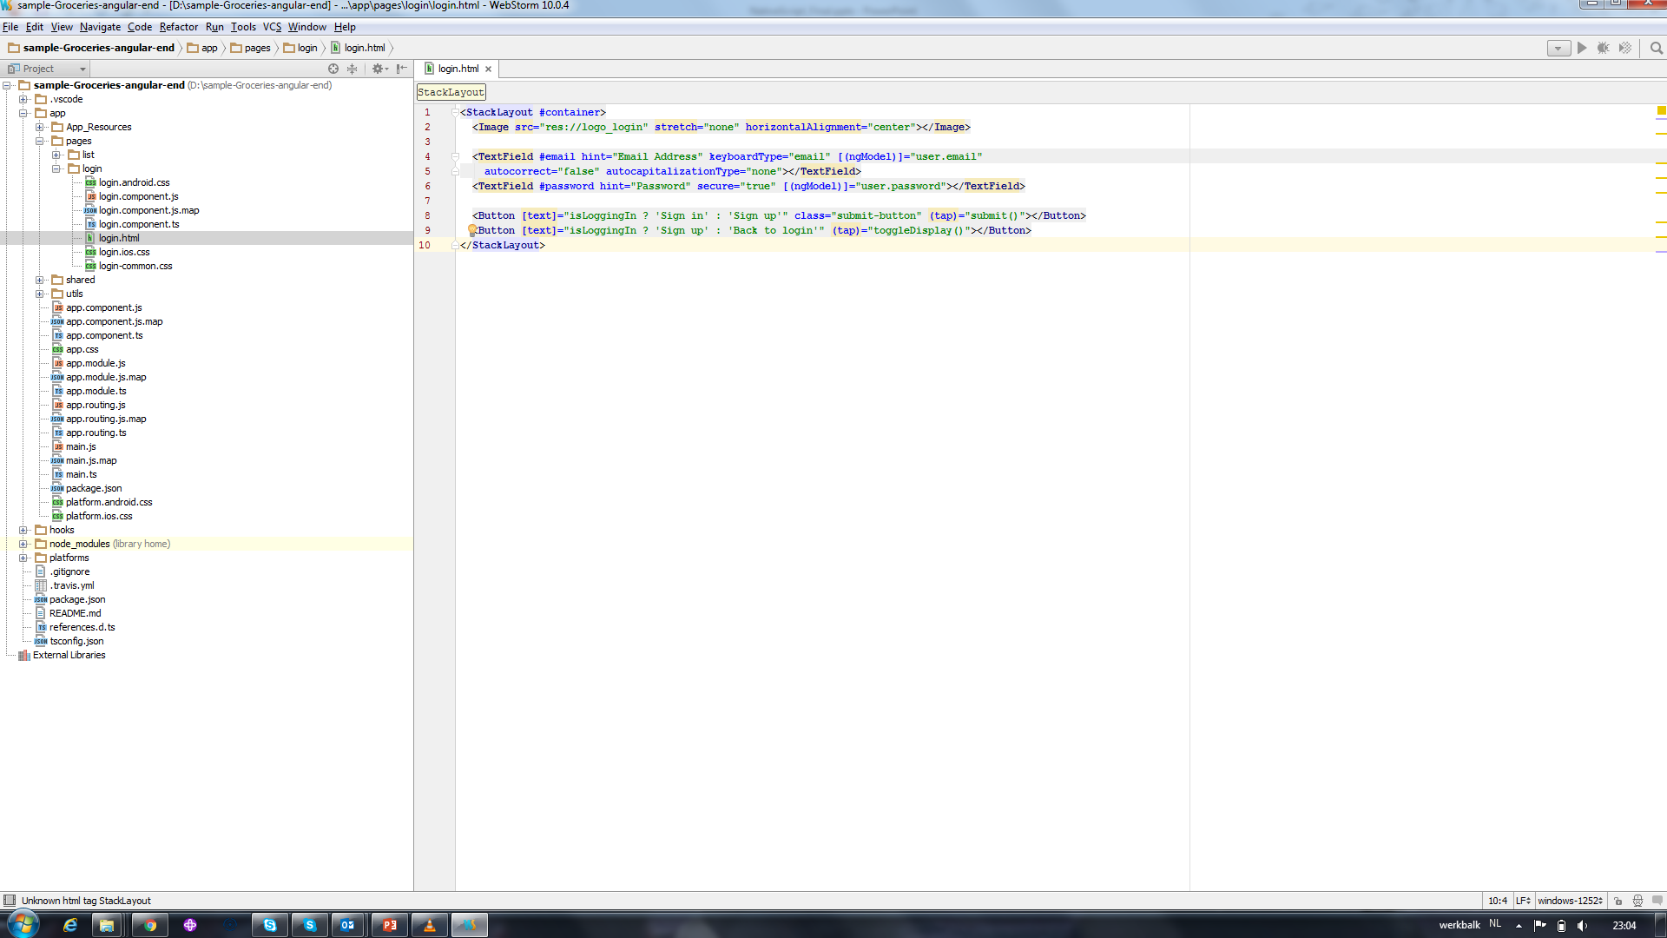
Notes:
16.15

Slide 44
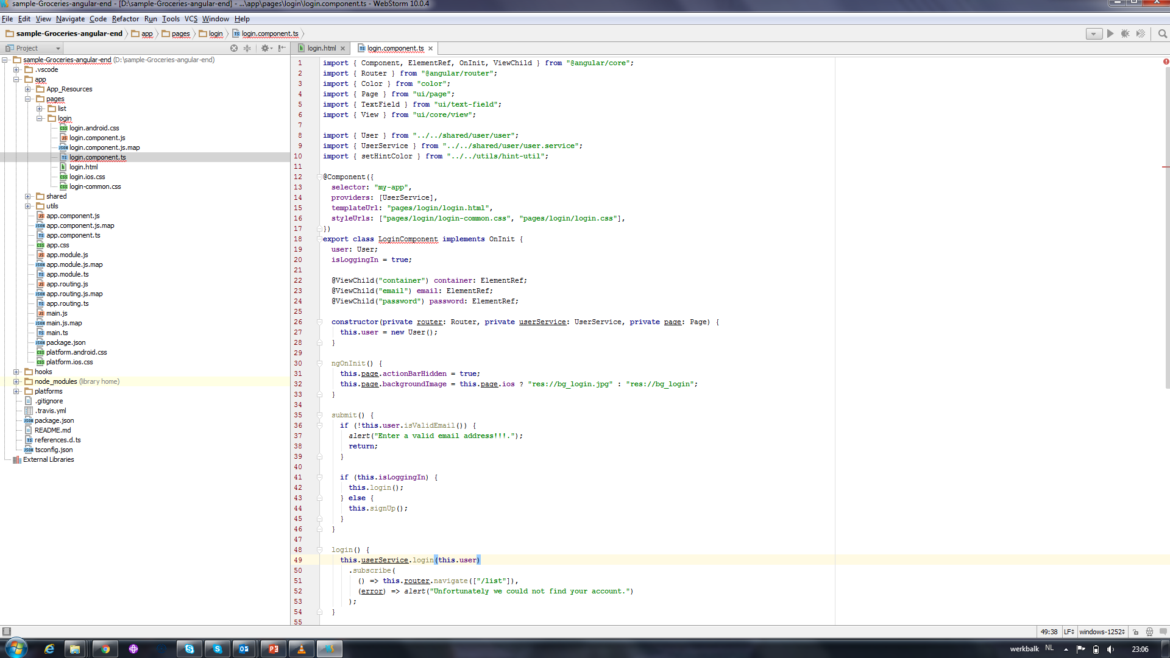
Notes:
16.47

Slide 45
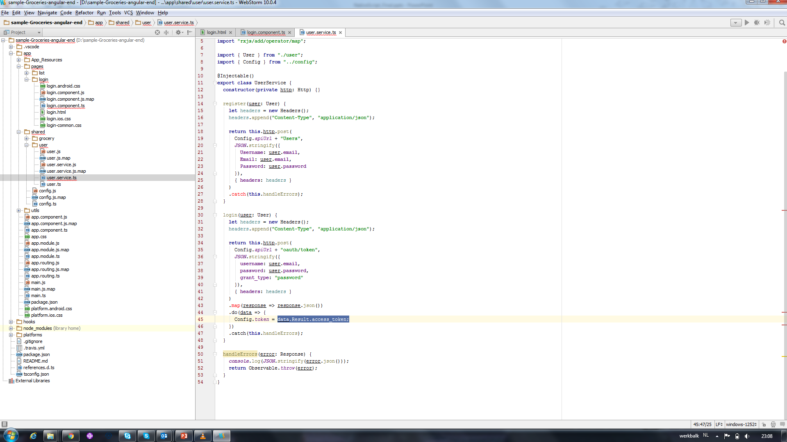
Notes:
17 min t/m 17.35

Slide 46
Using Workers for Background Threads
Web Workers provide a simple means for web content to run scripts in background threads.
The worker thread can perform tasks without interfering with the user interface.

Slide 47
Using Workers for Background Threads
require( 'nativescript-webworkers' );
var myWorker = new Worker('~/test.worker.js');
myWorker.onmessage = function(m) { console.log("Webworker said:", m); };
myWorker.postMessage("Hello");
test.worker.js
onmessage = function(m) {
console.log("NativeScript said" + m);
};
onready = function() {
postMessage("Hi");
};

Slide 48

Camera

Slide 49
Camera
<StackLayout>
<Label text="Tap the button" class="title"></Label>
<Button text="Take Photo" (tap)="onTap()"></Button>
<Image [src]="mySource"></Image>
</StackLayout>

Slide 50
import {Component, OnInit} from "@angular/core";
import cameraModule = require("nativescript-camera");
import imageSource = require("image-source");
@Component({
selector: "my-app",
templateUrl: "app.component.html",
})
export class AppComponent implements OnInit {
public mySource: imageSource.ImageSource
public onTap() {
cameraModule.takePicture({
width: 300, height: 300
}).then(imageAsset => {
imageSource.fromAsset(imageAsset).then(resImageSource => {
this.mySource = resImageSource;
})
});
}
}

